Slide 1
The Focus Tax How can you pay less tax?
Kurt Nitz Layperson, Christ Our Savior - Rockford, Michigan
Notes:
Examine Focus Taxes
Explore how they get levied & what taxes may be costing us,
Understand what we can do to find our focus
Consider some things that you can do as a leader to promote focus on your group or team.

Slide 2


A
What works best?
1
1 2 3 4 5 6 7 8 9 10 11 12 13 14
What works best?
B
2
1 2 3 4 5 6 7 8 9 10 11 12 13 14
Notes:
On the front of your handout there are 4 lines that look like this. You’ll need a pen.
In a moment, when I say go, I am going to have write some stuff on these lines - we’ll work in the first round with the top pair - lines A & 1. First, on the A line, you are going to write the question “What works best?” Once you’ve completed the A line, then – and only then, you will write the numbers 1 through 14 in sequential order. One last thing (pop up timer). As you may expect from the Round A1 Time box, this is a timed exercise. Once you finish both lines – A & 1 - one, look up here, write your finish time in the Round A1 Time box, and raise your hand & keep it up to show that you’re finished.
Before I have you begin, are there any questions?
Ready, Set, Go!
Alright! Looks like we are ready to proceed to round 2. We’ll do this using lines B & 2.
In this second round, once I say go, you’re going to write the same 2 phrases on these rows. Just like in the 1st round, in the B row you’ll write “What works best?” and in row 2 you’ll have a sequential list of numbers. However, the process will be slightly different: you will alternate between the rows. For every letter you write in the “B” row, switch to the fourth row (labeled “2”) and write the corresponding number. After you have completed the last number (14), record your time in the Round B2 Time box, and raise your hand & keep it up to show that you’re finished.
Ready, Set, Go!
Let’s compare your results between the first and second rounds.

Slide 3
Exercise Debrief
What did I just have you intentionally do in round 2?
What was the impact on the duration of the task?
What was the impact on the quality of work?
What was the impact on your mood or state of mind?
What else did you notice?
Notes:
Group Debrief
Multitasking
generally understood as consciously doing multiple tasks simultaneously
does not exist; instead, your brain is Switchtasking
Switchtasking = attempting to do multiple attention-requiring tasks at the same time – your brain doesn’t process both simultaneously but instead switches back and forth between both.
Each switch in attention incurs a switching cost,
Takes much longer to complete the exercise
See a considerable decrease in the quality of work (errors, cross outs, legibility, neatness)
Experience more personal stress, irritated, (unhealthy state of mind)
IF raised, Background tasking = performing a task while your subconscious handles another task in the background. (Unlikely anyone was background tasking)
The reset cost of switch tasking is one type of focus tax that reduces your productivity and ability to get stuff done.
The thing is – the focus reset tax associated with trying to multitask but instead just switchtasking is just one way we get charged focus taxes. And, the cost for these taxes may be higher that you think. While a lot of these taxes are of the nickel and dime variety, they unfortunately can add up to a pretty big bill.

Slide 4

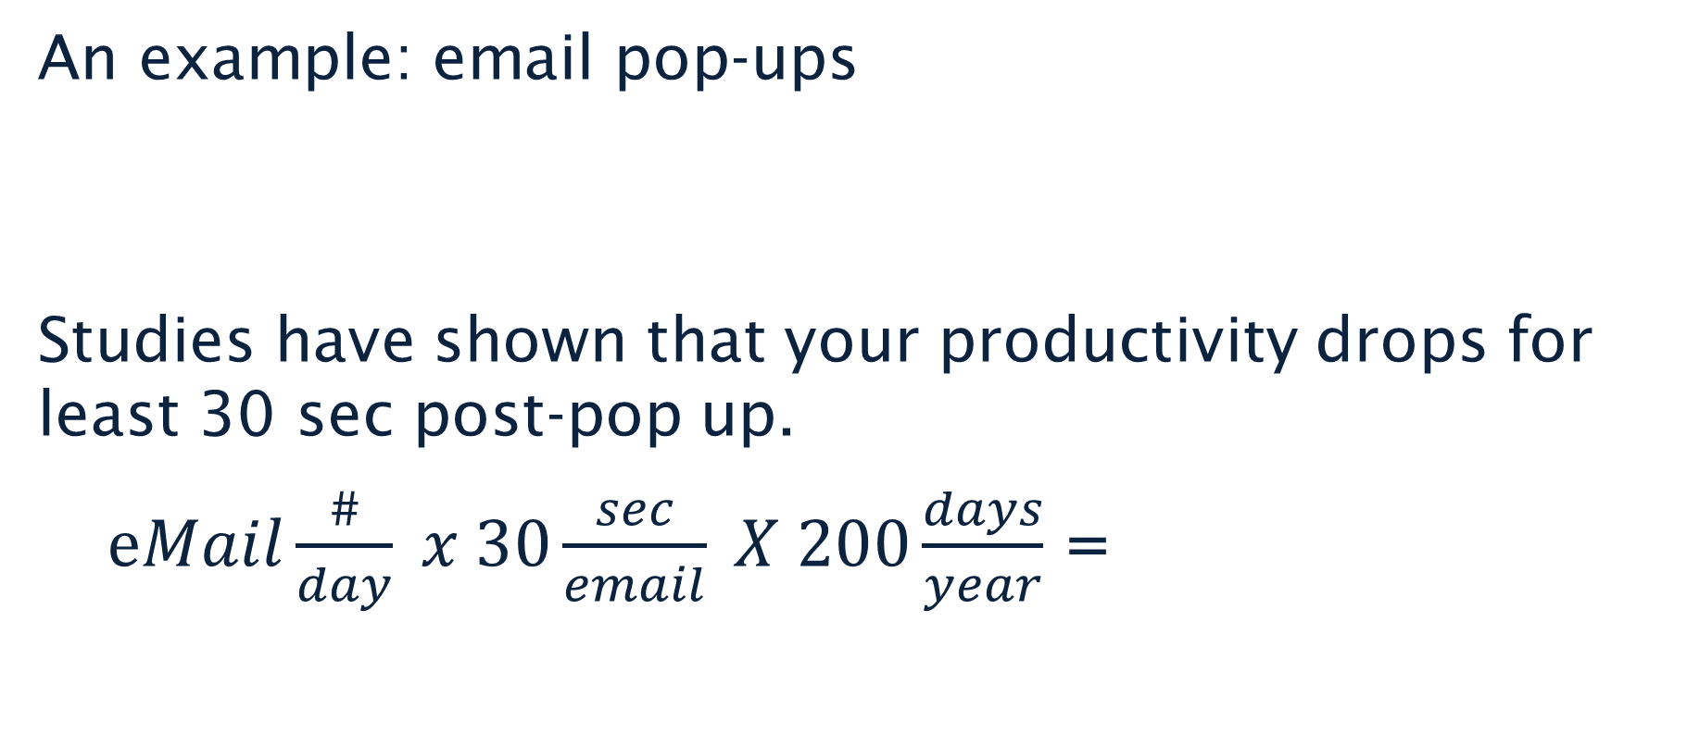
How much do Focus Taxes cost?
An example: email pop-ups
Studies have shown that your productivity drops for least 30 sec post-pop up.
$eMail\frac{\#}{day} x 30\frac{sec}{email} X 200\frac{days}{year}$ =
a lot of stuff you could have done
Notes:
100 email/day = 167h/year (>4w!!)
30 sec at a time – just like taxes, we’re getting nickeled and dimed to death.
But for most of us, email pop ups are amateur hour – if you’re looking to really cut your focus taxes there’s a better place to look…

Slide 5

Cell Phone Focus Taxes
More people have access to cell phones than to working toilets
The average person checks their phone
110 times/day
Nearly once every 6 sec in the evening
Check e-mail & respond to texts during test
10 to 15 point IQ loss
2x from smoking marijuana
Equivalent to dropping IQ from that of young adult to pre-teen
Notes:
I am of course talking about our pocket brains: cell phones
More folks have cell phones – more taxes
Attention grabs WAY higher than just pop-ups
And once again, what’s the impact?
Study @ Institute of Psychiatry at Kings College London divided volunteers into two groups. Each subject took an IQ test. One group had to check e-mail and respond to instant messages while taking the test, and the second group took the test without any distraction. Distracted workers suffered a 10 to 15 point IQ loss. (2x from smoking marijuana, equivalent to dropping IQ from that of young adult to pre-teen)

Slide 6
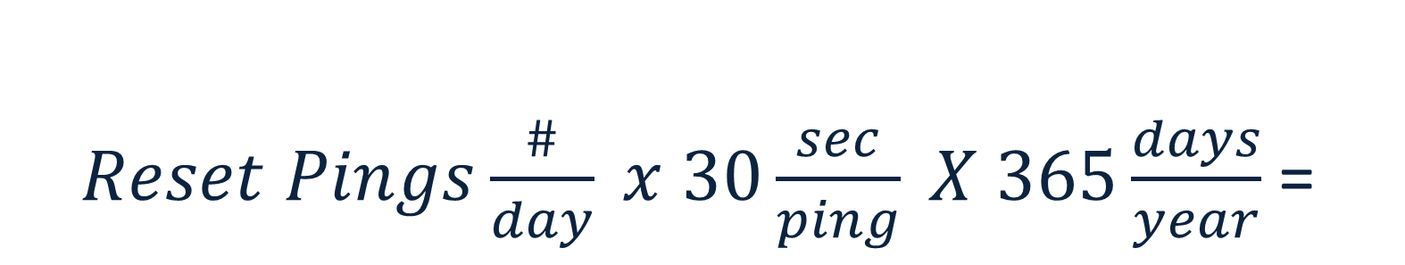
What are you paying in Focus Taxes?
We experienced the reset tax of switch tasking
The same reset tax is charged for email pop-ups and phone notifications
$Reset Pings\frac{\#}{day} x 30\frac{sec}{ping} X 365\frac{days}{year}$ =
Notes:
Reset tax for switching attention
Slower
Less effective
Mood / Unhealthy state of mind
Turn to p. 2 of handout; feel free to use the calculator on your phone – I’d like you to calculate your reset tax for pop-ups and notifications;
How many pings – email pop ups or phone notifications – do you get on an average day.
Equation is tax in seconds/y
Divide by 60 to get tax in minutes/y
Divide by 60 again to get tax in hours/y
10 ping/day = 30h/y
Just for notifications & pop-ups… but there’s other ways for the focus tax bill to go up!

Slide 7
Focus Taxes
Switching between tasks
More goals and objectives
Complexity
Lack of clarity on what’s important
The Fix It Now Train
Reset Tax payment
Creates more payments
Increases the fee
Increases the fee & Creates more payments

Slide 8
The Fix It Now Train
This is a problem
Problems are bad
Fixing problems is good
We should fix this problem
We should Fix It Now

Slide 9
Focus Taxes
Switching between tasks
More goals and objectives
Complexity
Lack of clarity on what’s important
The Fix It Now Train
Makes switchtasking more likely
Means we’ve perhaps not fully thought through everything ⇒ Less clear
Reset Tax payment
Creates more payments
Increases the fee
Increases the fee & Creates more payments
Creates more payments
Increases the fee
Notes:
Fix It Now conclusion
Transition
We’re all paying focus taxes – how do we find our focus and pay less tax? If we’re going to reduce our tax burden, we need to consider how our focus works and how it is being taxed.

Slide 10
What is “Being Focused”?
Thinking about one thing while filtering distractions
Exercising Cognitive Control
brain’s executive function
originating in the prefrontal cortex
same neural circuitry that manages unruly emotions
Willpower
Notes:
The common meaning of “Being Focused” is thinking about one thing while filtering distractions
Cognitive Control is the scientific term for putting my attention where I desire it to be and keeping it there & not having it wander. This focus is one aspect of the brain’s executive function, which is located in the prefrontal cortex. Another term for it is “will power”. The same neural circuitry that allows such a single-minded pursuit of a goal also manages unruly emotions.
Considering how our cognitive control neural circuitry works will help us consider various strategies to pay less focus taxes.
Next 3 slides are the meat of this presentation – not actionable, but lets you choose your action

Slide 11

Rider • Elephant • Path
Equip the Rider
Clarity = an equipped Rider
Engage the Elephant
Enthusiasm = an engaged Elephant
Ease the Path
Quick, short, simple = an easier Path
Notes:
Rider • Elephant • Path is a useful model for examining our cognitive control. In this model
Rider is the intellectual response
Elephant is the emotional response
Path is the journey we are taking in an effort to accomplish something – changing culture in an organization, completing a task such as filling in an expense report
Rider holds the reins and seems to be in charge. In reality, the Rider’s control is limited – anytime the rider and elephant disagree on the course to be taken, the Rider will be overpowered by the 4-ton Elephant. For the Rider to have any chance of directing the Elephant, he can’t be uncertain; he needs to be fully equipped with all the relevant information and facts.
So the Rider’s ability to steer is always somewhat limited. Additionally, the rider’s ability to steer will ebb as the rider gets tired. This is a big issues in paying focus taxes.
The Elephant is lazy and easily distracted. This has a GIANORMOUS impact on focus taxes.
The path needs to be considered – can I make it shorter or reduce distractions?
What we call willpower - establishing and maintaining our focus – can be viewed as the rider exercising self-restraint over the elephant

Slide 12



Focus Cycle
Choose a focus
Your attention wanders
Recognize that your mind has wandered
Notes:
Choose a focus
This requires cognitive control (i.e., the rider) to engage on the object of focus and
Then to maintain it, requires additional cognitive control (the rider again!) to keep your attention there
Your attention wanders – This isn’t what you plan to do – it just happens. The Rider got tired, the elephant saw something just SO interesting
Sooner or later, you recognize that your mind has wandered. You notice the distraction. You realize how far you are from the first thing you wanted to focus on.
After recognized the mental detour, you may choose to refocus. Then again, you may choose to give up and move on to something else. It’s up to you; it’s your choice.
3 points from this cycle that can help us build up our ability to focus
Once you recognize that your mind has wandered, notice what CAUSED your mind to do so
Is there a way to put up a fence on your path so the elephant doesn’t go there
Can you do something to give the Rider more energy so they don’t tire as quickly

Slide 13
Managing Your Energy
physical – base level of energy
nutrition, exercise, rest, sleep, relaxation
emotional – energy of mood
healthy state of mind, curiosity, gratitude, appreciation
mental – energy of focus
clarity, reduced interruptions & distractions
inspirational – energy of purpose
serving others, making a meaningful difference
Notes:
4 Dimensions of energy
All cross connected
Task without purpose ->easily distracted
Tough Mental challenge -> end feeing physically tired
Mood can also impact your ability to focus
Managing your energy is more important than time management for healthy, high performance – including for maintaining focus.

Slide 14
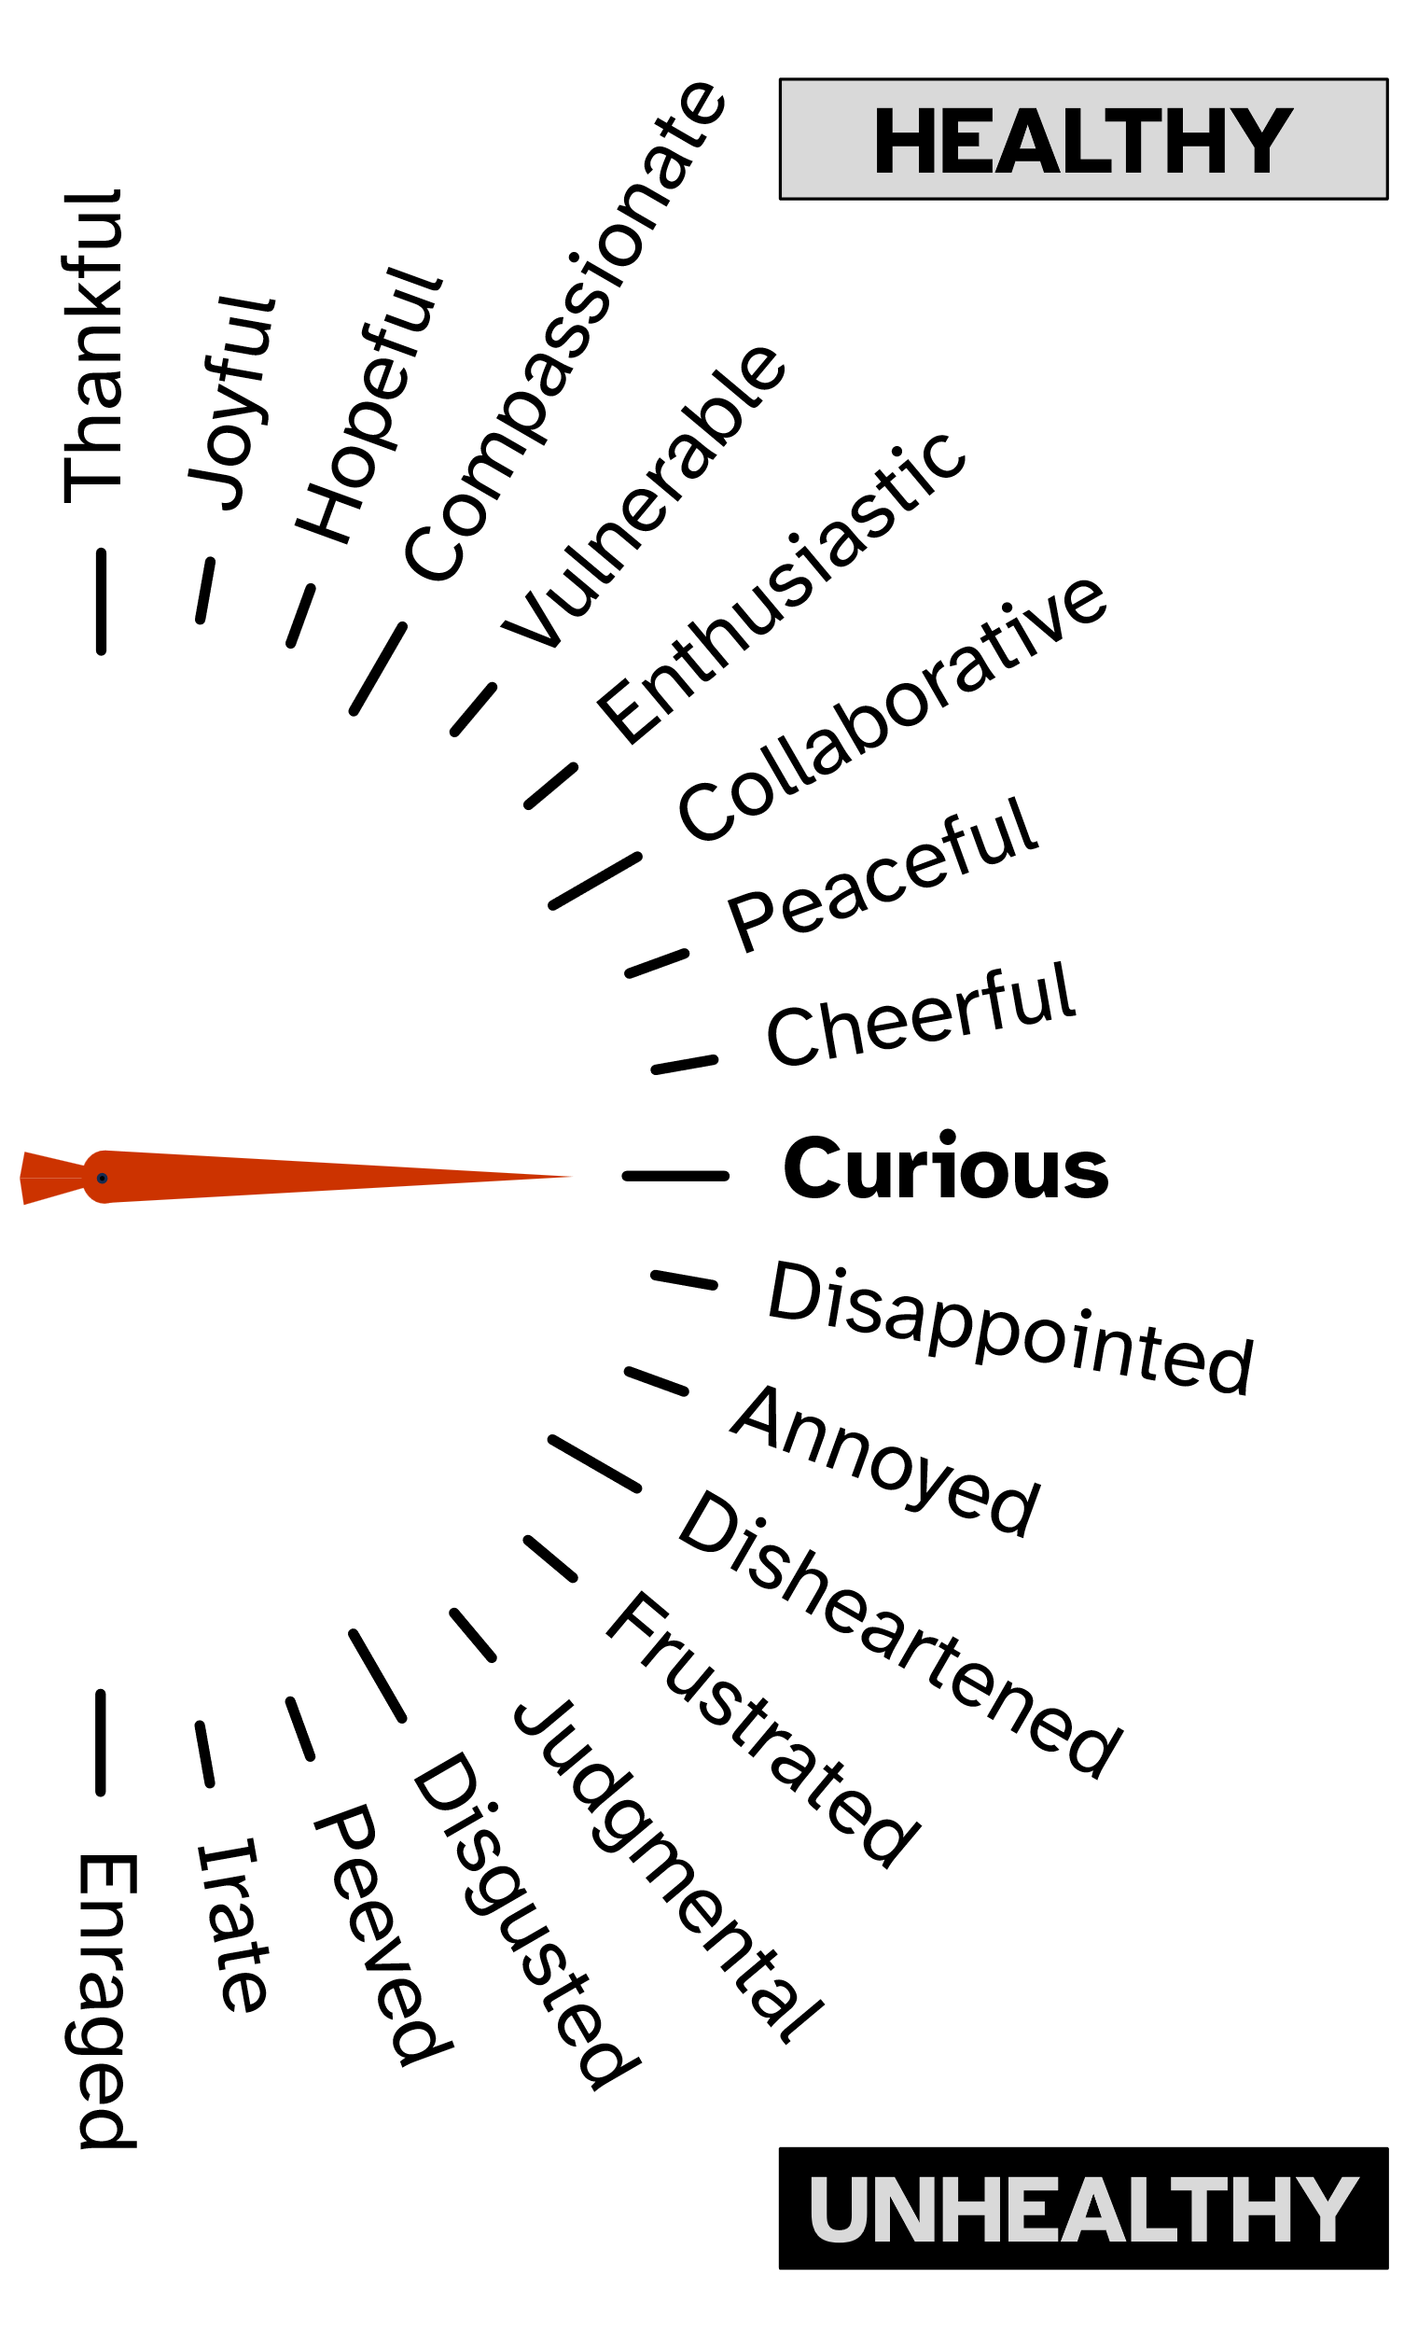
Mood Meter
Mood is an indicator for your state of mind & quality of thinking
High on Mood Meter
Healthy State of Mind
Better able to focus
↑ time in Healthy State of Mind
Be Curious
Practice an Appreciation Mindset
Notes:
Our place on the mood meter will fluctuate from moment to moment
Top & bottom halves can be labeled as healthy and unhealthy states of mind
Way more moods that these – certain ones may show up more frequently for us – helping or hindering our efforts
You are at your best … and most able to focus… when you are in a healthy SoM
Mood will fluctuate, be aware of it and be able to shift it back up to a healthy state of mind
Curiosity has a special role
Appreciation Mindset: Always look for opportunities to show appreciation and express gratitude
(3 things per day crates measurable differences in brain)

Slide 15
Managing Your Energy
physical – base level of energy
nutrition, exercise, rest, sleep, relaxation
emotional – energy of mood
healthy state of mind, curiosity, gratitude, appreciation
mental – energy of focus
clarity, reduced interruptions & distractions
inspirational – energy of purpose
serving others, making a meaningful difference
Notes:
So, while we’re going to move on to a deeper dive of on the mental dimension of our energy, realize that the rider’s cognitive control is impacted by all 4 dimensions. Managing our Energy in any of these dimensions will improve our ability to focus.
Transition
We’ve covered
Rider • Elephant • Path
Focus Cycle
Managing your energy
You are now ready to…

Slide 16
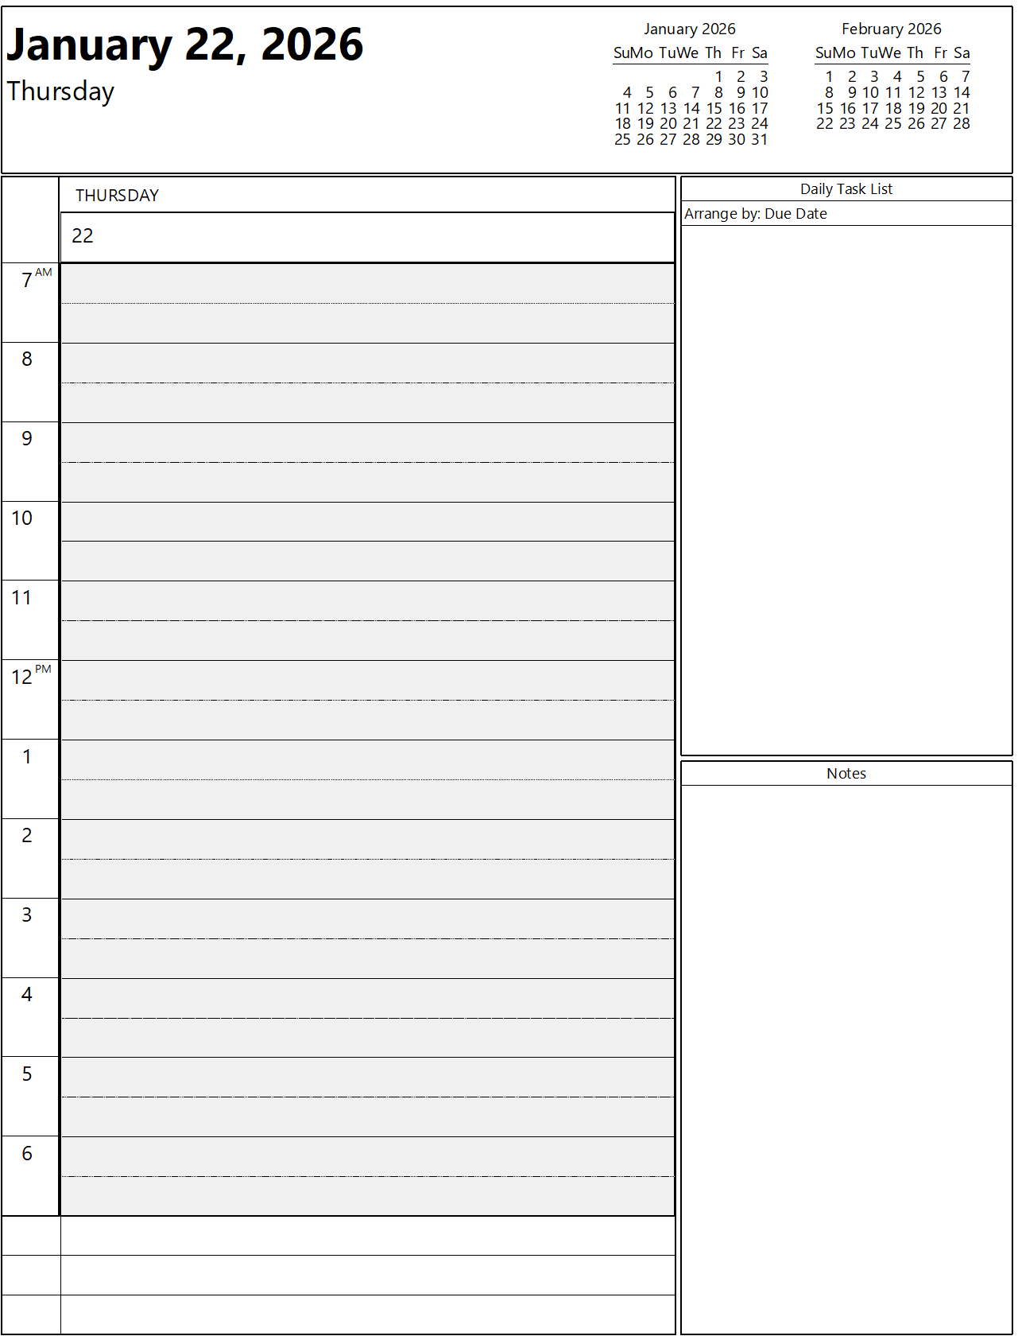

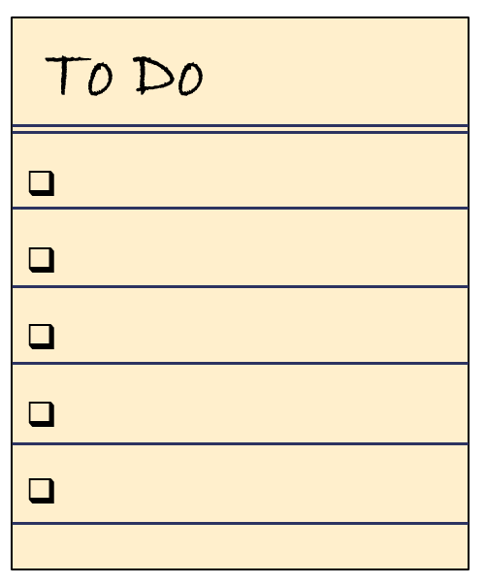
Choose Your Weapons Wisely
Whether you think an idea to help you focus is great or garbage, you’re probably right.
*
* Evaluated by the Rider, not picked by the Elephant
Notes:
…choose your weapons wisely.
Here are my weapons of choice for day-to-day focus when I was a plant manager in Portland, OR
Review email at home prior to commute
At plant, print calendar
Xfr open items from yesterday’s To Do list, to today’s, add any new items
pick top 3
With this I was “parked facing downhill”: car on a slope facing downhill, only need to lift foot off the brake to get moving
Calendars, planners, To Do Lists – our response to these tools will vary because we don’t all think the way
Yeah! Tools to help!
Boo! Stifling tools.
Productivity strategies lose their potential to motivate when they don’t feel meaningful. If someone else’s productivity strategy feels artificial to us, then it is unlikely to click.
Great or garbage will vary from person to person. But do NOT just trust your gut; I hope everyone tries turning off pop-ups and notification for 2 weeks – give it a quick test and see if it works for you.
Just like there’s not a move that eliminates all taxes, for no single tool will help you develop laser-like focus that never wanders. You are just looking to pay LESS tax.

Slide 17
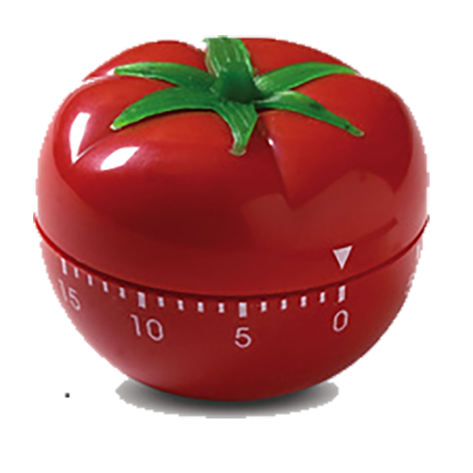
Pomodoro Technique
Choose your task(s) (Pomodoro) - bunch or break tasks to a 25 min block.
Set the timer to 25 minutes
Work on the task for 25 minutes.
Take a 3-5 minute break for energy renewal, start another Pomodoro.
Take a 15-30 minute break after completing four Pomodoros.
Notes:
A lot to like here from a Rider Elephant Path perspective:
You’re managing energy with frequent breaks, keeping the rider strong; will power is a renewable resource (Breaks are not optional for that reason.)
The path is short, just avoid all distractions and urges to multi-task for 25 minutes.
Eng in PDX loved this – didn’t stay as late once he started doing this.

Slide 18
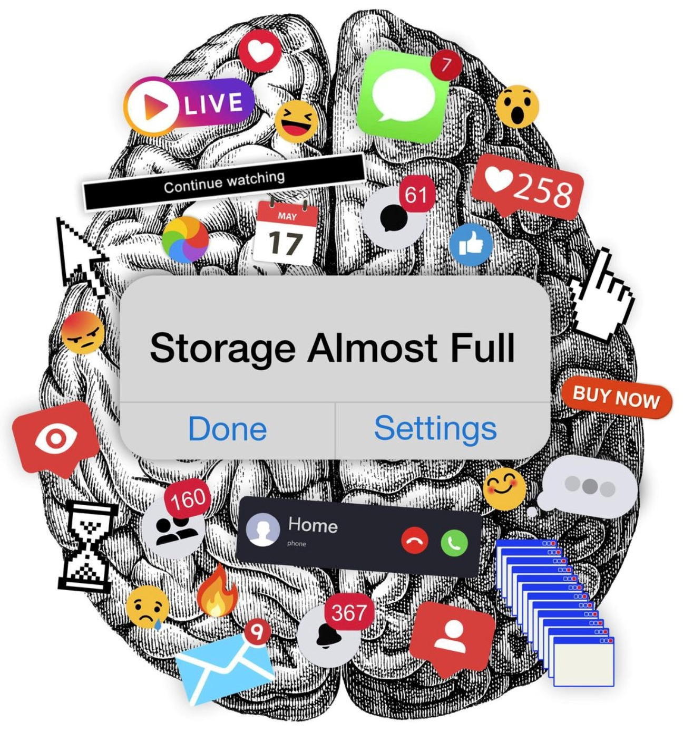
Clarity for Focus
Top three personal priorities
Top three work priorities
Do you have enough focus on these priorities?
Do key others (your team/boss /spouse) know your priorities?
Are both the destination and full path clear for these priorities?
Are there less important things on my plate that are getting in the way of these priorities?
Notes:
A busy mind with tons of churn is a focus challenge
Questions on p. 3 - we won't have time, do on own.
deciding what not to do is as important as deciding what to do
“If you don’t know where you’re going, you’ll end up someplace else.” (Yogi Berra)
Having Clarity for self means that the cognitive load for the rider is reduced & they have more energy to steer the elephant.
Knowing that less important things are “jumping the line” is something that you may be able to use to change the path.
Lastly, it is easy to assume that folks know our priorities, but their rider’s have their own elephants to steer. They can’t adjust to help you unless they know.
Lots of our talk on being more focused is about equipping the rider, with energy and clarity. What about helping the elephant be less distracted, building some fences.
Your elephant is different from mine, but there’s one distraction source that is common to many of us…

Slide 19

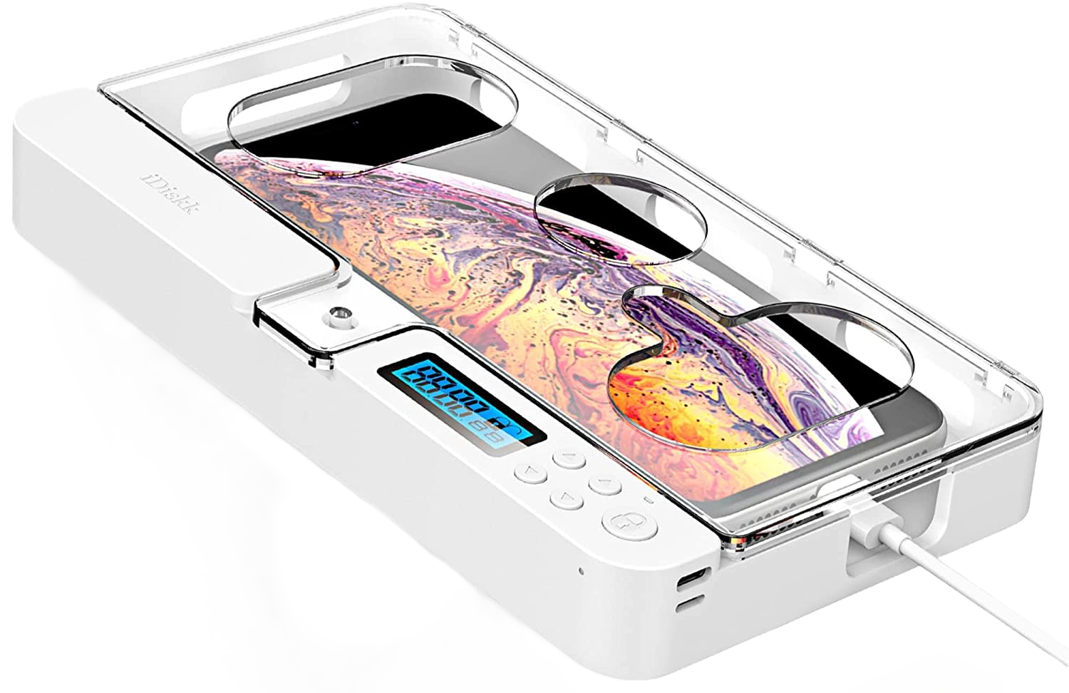
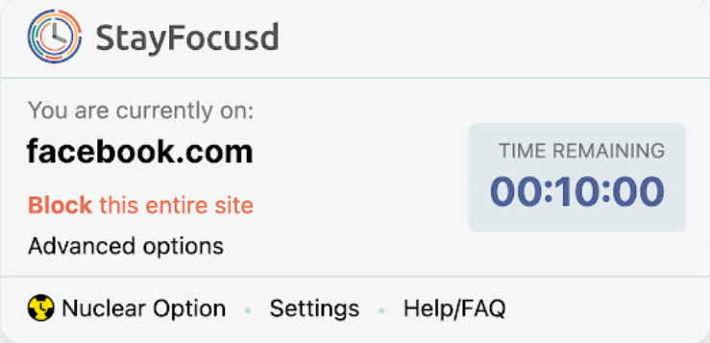
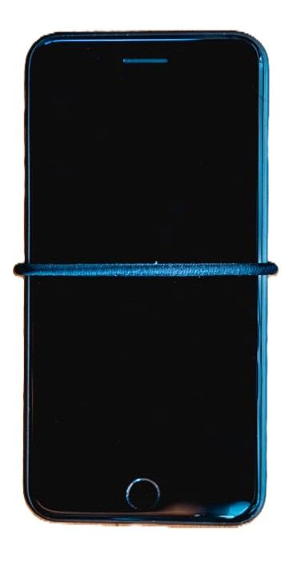
Mitigate Phone Distractions
Delete time-wasting apps
Go Gray (your phone without makeup)
Phone not in bedroom at night
Phone Lockbox
Get an app to lock up other apps or limit their screen time
Set aside your phone one day/week
30-day reset (call & text only, nothing else – not even maps)
Hairband Trick – greater awareness of each use
Notes:
Distraction didn’t start with the cell phone.
Phones are incredible at attention consumption – by design.
Designed to grab attention (Minimal effort on your part)
Designed to hold attention (ease the path – requires zippadee cognitive effort)
But attention is a mental muscle – like any other muscle it can be strengthened through the right kind of exercise. We can also get out of shape. Phones don’t just grab attention; they've designed the path so well that the elephant can go on autopilot because the path requires so little cognitive effort. This creates flabby focus muscles.
Lot of fencing – making the phone less able to distract (delete app, go gray, phone in bedroom, lockbox)
Even a bit of equipping the rider by managing your physical energy (phone in bedroom = less sleep)
Use rider to limit use before rider is weakened by 30 minutes of doom scrolling
Training my elephant to be less habitually distracted (1d/w set aside, 30 day reset, hairband)
What other tools or hacks do you have?

Slide 20
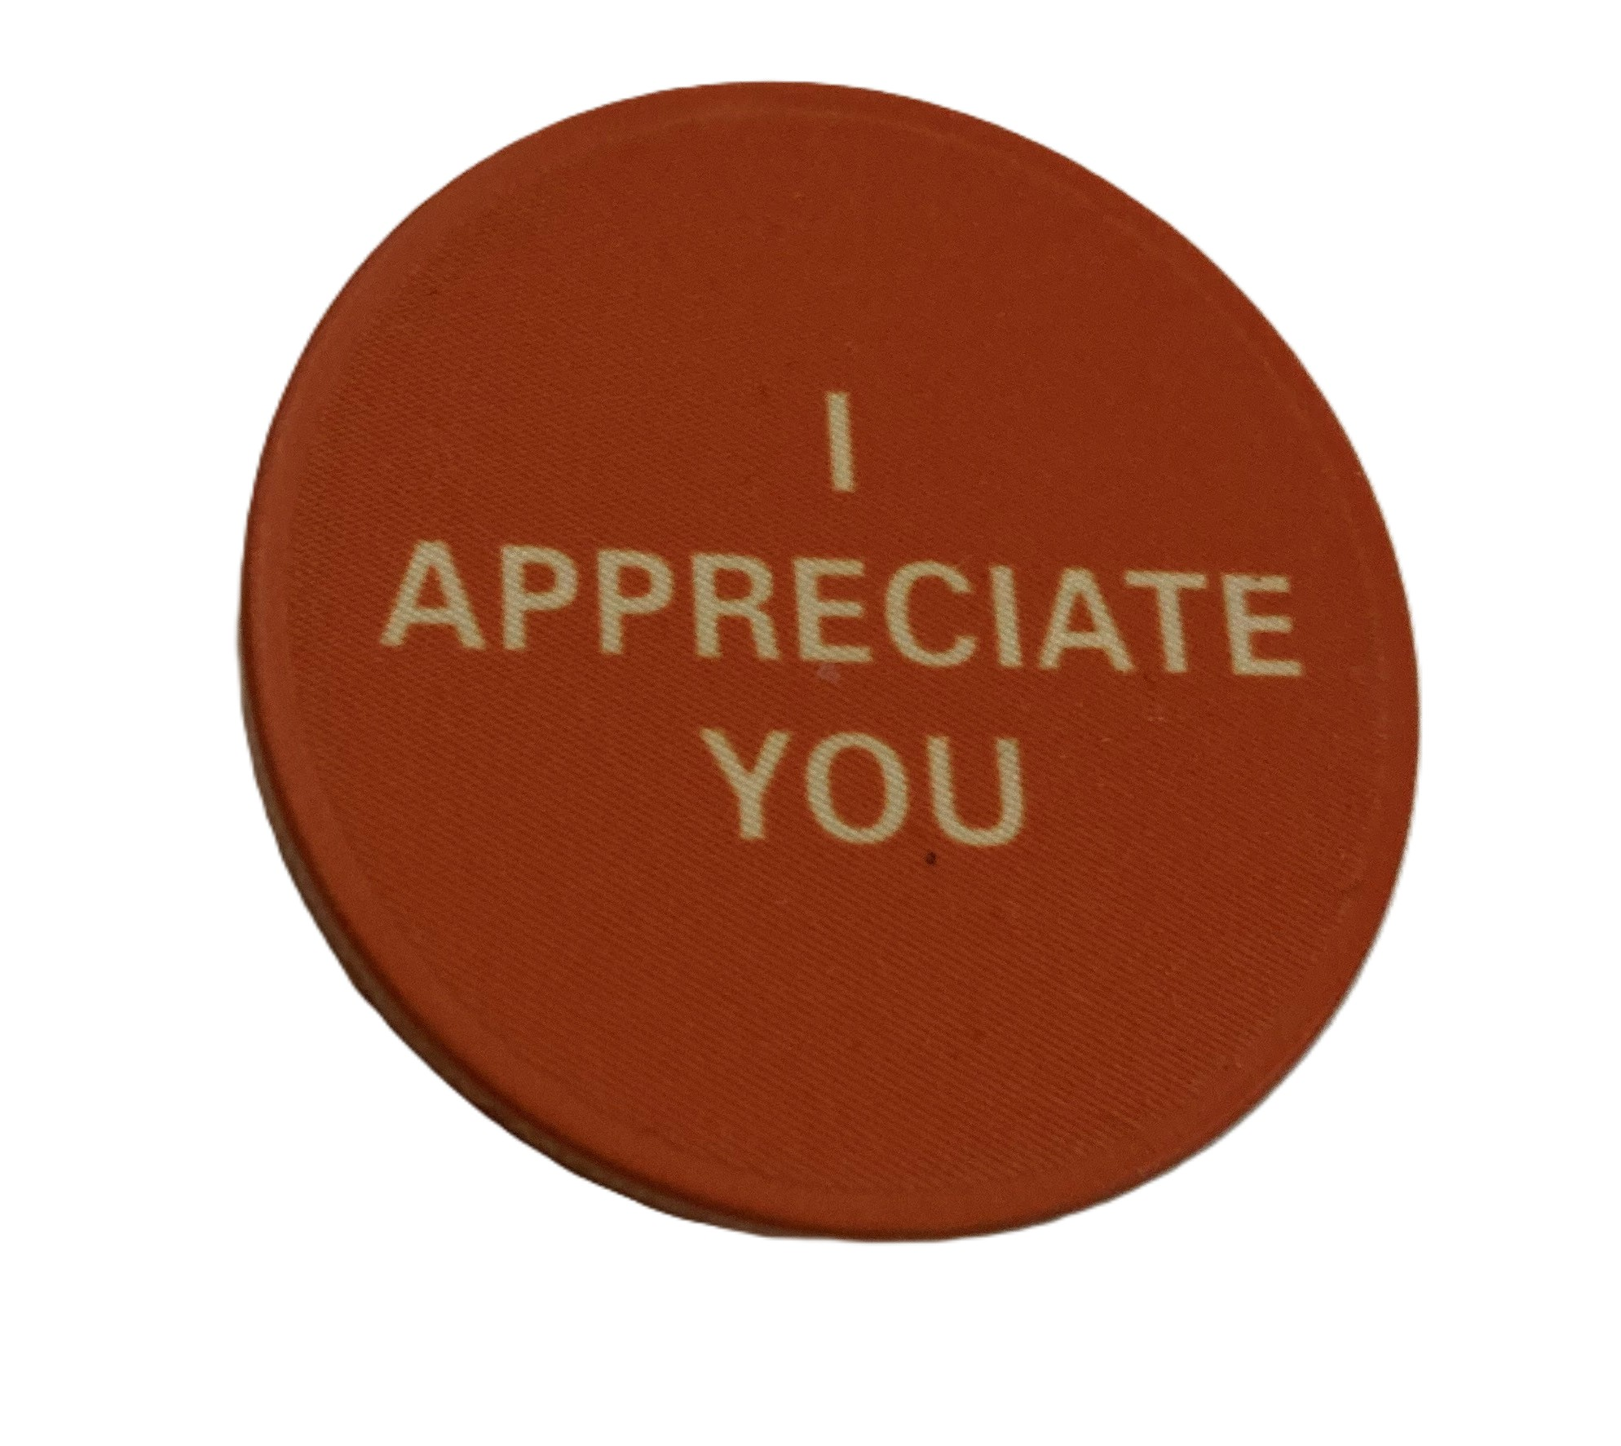
Leading for Focus
Put on your own oxygen mask first, before helping others
(unless you’re the one requiring special assistance)
Do Fulfil your Focalizing Function
Don’t be a Focus Problem Child
Consider focus impact of cultural artifacts using Rider • Elephant • Path
DOs
Provide clarity
Manage plate portions
Connect goals to purpose
Voice Appreciation
DON’Ts
Fix It Now Train
Mood bombs
Notes:
Leaders have a special opportunity to help create focus for others!
Leader – are you the one requiring special assistance – find someone on the team with focus as their superpower and/or rely on systems/processes that address this weakness
Artifacts – promote expressing gratitude with appreciation coin
Other examples of artifact:
how you set goals
Meeting agendas
Project Management Rules

Slide 21
What is most important, right now?
If an organization wants to create clarity and alignment, it must have a single top priority within a given period of time.
“If everything is important, nothing is.”
Thematic Goal
Singular (one thing!)
Qualitative (NOT quantitative!)
Temporary (clear time boundary, usually 3-12 months)
Shared by all on Leadership Team (even if the goal is mostly within one or two Leadership Team members’ areas of responsibility)
Notes:
When does any organization have peak focus – crisis
Ex. Fire severely damages church sanctuary – needs to find a place to worship by next Sunday
Local gym, need chairs, let folk know (3 Do’s)
Compare to how long the task would take if a change of pace experiment
Why the change in focus? – blazing clarity, emotional buy-in, only thing on the plate, this is go-no go for worship
(3 Do’s, Rider Elephant Path)
characteristics of the Thematic Goal? (discuss per above)
1st 90d: one thing – rider clarity, identified by them - elephant enthusiasm, quick win – short path

Slide 22
Team Daily Check-in
Every workday (never cancel); same time (early-ish), set place
Standing
5 minutes in length – location suggestion: gemba
Can be an add-on to another meeting
Agenda
Round-robin: top 3 (or fewer) individual priorities for the day
Quick Questions & Emergent Issues
No problem solving – take issues off-line as needed
Notes:
Declare priorities in front of group/boss
Eliminates drive by discussions & email chains
Folks hate the idea, but every 2w trial results I’ve done results in adopting it

Slide 23
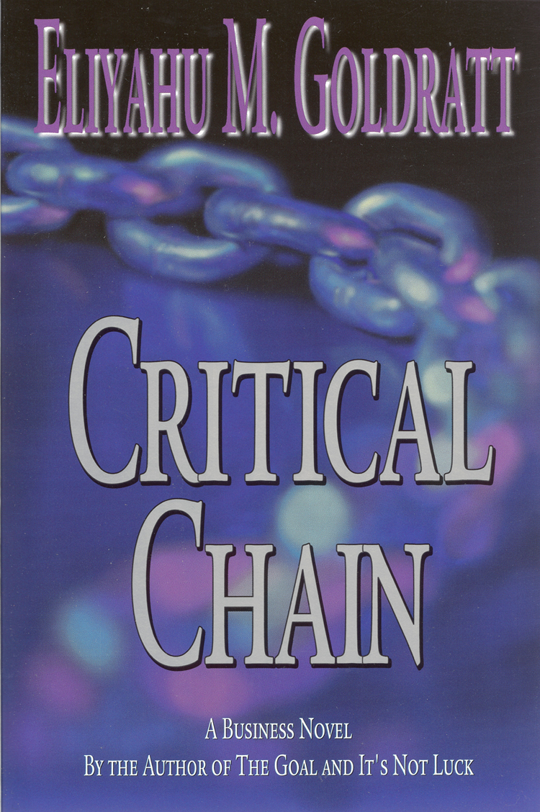
3 Project Rule
No one may be assigned to more than 3 active projects
Notes:
From Critical Chain – Goldratt
Israel Aerospace Industries
– Refurb engineer managing 10 to 20 aircraft maint projects down to 3
– 3 mo turnaround to 2 weeks
Adv to show geek graph
2 special reset taxes associated with projects
Obstacle tax – switch from focus on barriers because other projects need to progress, too and those don’t have this obstacle
Overflowing Plate Tax – to show progress on all my many, many active projects this week, I’ll need to switch my focus more times than if I just had 3 projects
Mood impact of juggling too many balls? (Negative for most engineers – they’re usually fairly analytical and like focused planning; perhaps would not be true in a salesforce)
MEMC (semiconductor firm)
Plant managers hated it
Forced compliance
40 to 50% more projects (in every plant that had not previously had a max # of projects restriction)

Slide 24





Journal
What insights have you had about focus?
What actions could you take to give the rider more energy for increased focus?
What actions could you take to remove distractions from the elephant’s path?
Create 1 to 3 WHEN/WILL commitments
Notes:
Give option: journal or Q&A
When / Will
DO discrete – specific when
BE – situational when

Slide 25

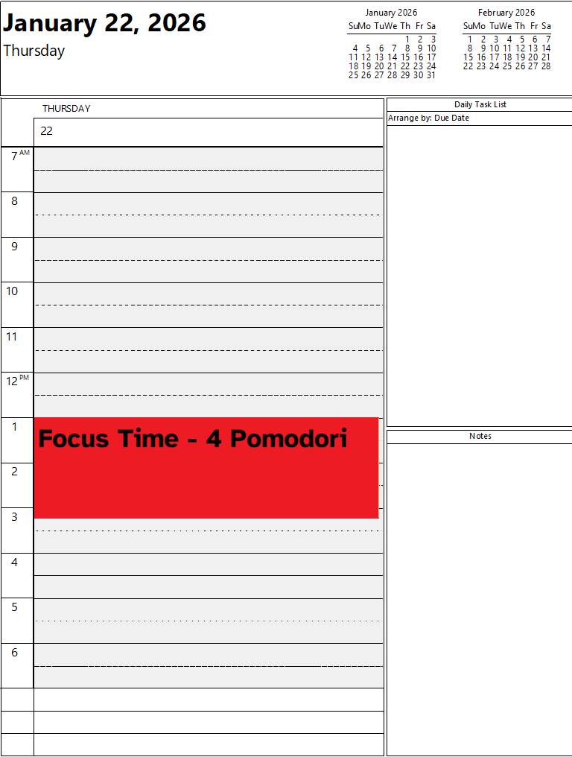
Daily ✓ Check-in
Reduce Pings
Turn off notifications
Use Do Not Disturb or Focus modes
3 Project Rule
Notes:
Show during Journalling

Slide 26
The Focus Tax
pay less tax
Notes:
Focus Taxes are real – and folks are getting nickeled and dimed to death.
Seeing the taxes, noticing distractions, moods, other things that impact my cognitive control means that I can impact this.
Understanding Rider • Elephant • Path means you are ready to
Equip the Rider by managing your Energy & creating clarity
Keep the elephant on task by recognizing distractions & adjusting the path to mitigate or fence them off
- doing that for yourself or for the teams you lead -
You can identify issues and (adv slide) pay less tax; increasing productivity and getting more stuff done.

Slide 27



